Slide 1
Weather Forecast Web App

Slide 2
Introduction
Good [morning/afternoon/evening]
Today, we're unveiling a groundbreaking Weather Forecast Web App. Accurate forecasts are vital for daily planning, safety, and various industries. Our app addresses the limitations of current services, providing not just data but a user-friendly, precise solution. Let's explore how this innovation will revolutionize the way we interact with weather forecasts.

Slide 3
Problem Statement
Existing weather forecasting services present challenges for users due to
Complexity: Current services may be overly complex, making it difficult for users to interpret and apply the forecast data effectively.
Inaccuracy: Users often experience unreliable forecasts, leading to inconveniences and potential disruptions in planning daily activities.
Limited User-Friendliness: Interfaces may lack user-friendly features, causing frustration and hindering seamless navigation for individuals seeking weather information.
Insufficient Customization: Current solutions may not offer sufficient customization options, leaving users with generic forecasts that may not align with their specific needs.
There is a pressing need for a more user-friendly and precise weather forecasting solution that addresses these challenges, providing accurate and easily interpretable data tailored to individual preferences.

Slide 4
Solution Overview
In today's fast-paced world, staying informed about weather conditions is crucial. Our Weather Forecast Web App is designed to be your go-to solution for accurate and real-time weather information.

Slide 5
Key Features
Real-Time Data:
Access up-to-the-minute weather updates based on the latest data from trusted meteorological sources.
Receive instant notifications for significant weather changes.
User-Friendly Interface:
Enjoy a sleek and intuitive design for seamless navigation.
Easily customize your preferences and settings with just a few clicks.
Customizable Alerts:
Set personalized alerts for specific weather conditions, ensuring you're always prepared.
Receive notifications via email or push alerts directly on your device.

Slide 6
Location-Based Forecasts:
Get precise weather forecasts tailored to your exact location.
Explore weather details for multiple locations, ideal for travel planning.
Extended Forecasts:
Plan ahead with extended forecasts, providing insights for the upcoming days or weeks.
View detailed information, including temperature trends, precipitation, and more.

Slide 7
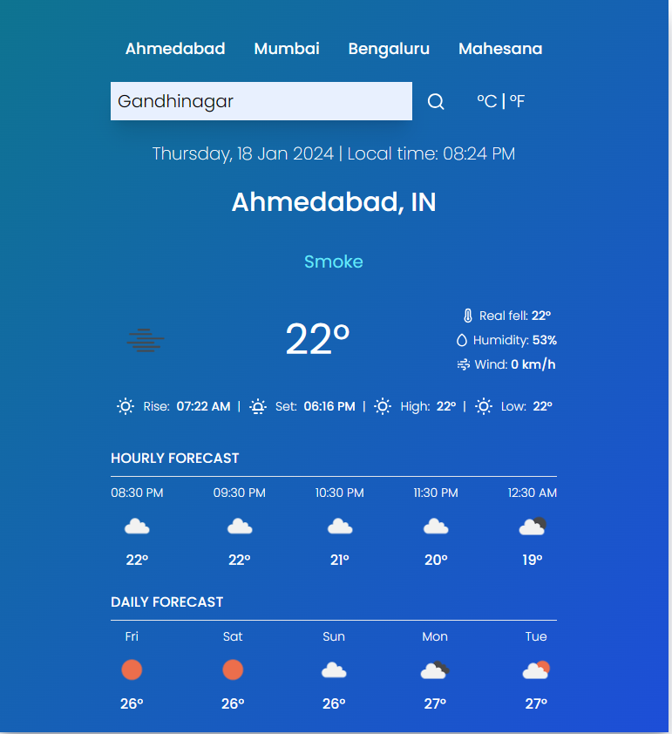
User Interface

Slide 8
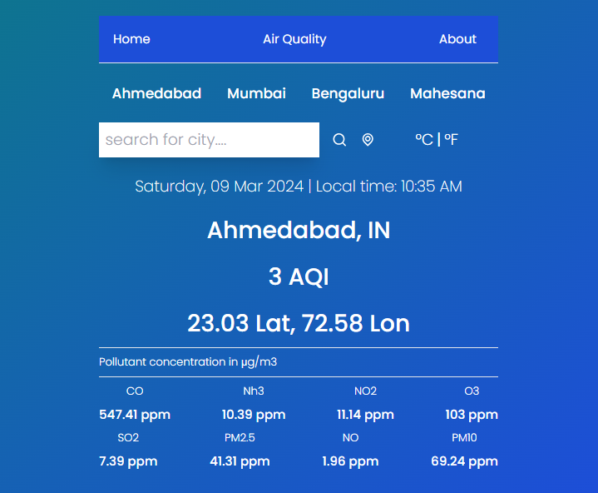

Slide 9
Technology Stack
Frontend:
ReactJS: A popular JavaScript library for building user interfaces. Enables the creation of dynamic and responsive UI components.
API Integration:
OpenWeather API: Integrate with this API to fetch real-time weather data. Provides a comprehensive set of weather-related information.

Slide 10
How its Work
Landing Page
Users can directly access the Weather Forecast Web App landing page without the need for registration or login.
Location Detection
The app automatically detects the user's location based on their device's IP address or browser settings.
Users also have the option to manually input a location if they are planning for a different area.
Instant Weather Overview
Upon landing, users are presented with an instant weather overview for their detected or selected location.
Key information such as current temperature, conditions, and a brief forecast for the next 24 hours is displayed.

Slide 11
Detailed Weather Information
Dive deeper into the weather details for the selected location.
Explore hourly and daily forecasts, including temperature highs and lows, precipitation chances, wind speed, and more.
Extended Forecasts and Maps
Access extended forecasts for the upcoming days or weeks to plan ahead.
Use interactive maps to visualize weather patterns and track any approaching storms.
Multi-Device Access
Enjoy a seamless experience across various devices, including desktops, tablets, and smartphones.
The web app's responsive design ensures consistent functionality and a user-friendly interface.
Conclusion
Users can exit the web app at any time without the necessity of creating an account.
The Weather Forecast Web App provides a hassle-free and informative experience, putting weather insights at users' fingertips without the burden of registration or login.

Slide 12
Customization Options
Temperature Units:
Users can customize temperature units based on their preference (Celsius, Fahrenheit).
Ensures a comfortable and familiar experience for users worldwide.
Location Preferences:
Set default locations for quick access to local weather.
Ideal for frequent travelers or users with multiple points of interest.
Forecast Display:
Customize the way weather data is presented (hourly, daily).
Flexibility to view forecasts in a format that suits individual needs.

Slide 13
Mobile Responsiveness
Cross-Device Compatibility:
Seamless experience across various devices - smartphones, tablets, and desktops.
Allows users to access weather information on the go.
Adaptive Design:
UI adjusts dynamically to different screen sizes.
Ensures a consistent and user-friendly experience on all devices.
Touch-Friendly Interface:
Designed for touch interactions on mobile devices.
Intuitive gestures for zooming and scrolling on touchscreens.

Slide 14
Thank You

